Slide 1
AN APPROACH TO INTERVIEWS FOR PROMOTION
By Vincent Mbazi Mudolo
(M.Ed; B.Ed; Dip.Ed)

Slide 2
An Overview
1. Background
2. Response to the advertisement of a vacant post
3. Preparations for the Interviews
4.The Interview Day
5. The Interview Assessment Criteria
6. Response to Interview Questions
- Suitability for the post
- Practical Questions
- General Questions

Slide 3
BACKGROUND
An interview is a conversation where questions are asked and answers are given in a one-on-one conversation with one person acting in the role of the interviewer and the other in the role of the interviewee.
A teacher is interviewed when he is being hired to become a teacher or for promotion as part of career advancement.

Slide 4
RESPONSE TO THE ADVERTISEMENT FOR THE VACANCY
Vacancy
Post : Secondary School Teacher (Grade TI)
Salary : Within Grade I salary Segment
Location : Various Education Divisions
Qualifications :
Applicants should be holders of any one of the following: Bachelor of Education, Bachelor of Science (Education), Bachelor of Arts (Theology/Divinity or Humanities) and should be serving teachers in Grades TL, TK and TJ

Slide 5
Duties and Responsibilities
(a) Teaching subjects in their area of specialization
(b) Attending meetings as well as general assemblies
(c) Preparing lesson plans
(d) Preparing and maintaining schemes and records of work
(e) Designing, preparing and developing teaching and learning materials for their subjects
(f) Assessing students and compiling test results
(g) Assessing students and compiling test results

Slide 6
(h) Maintaining records e.g. progress reports, attendance registers and scholastic information
(i) Participating in continuous professional development programmes (CPDs)
(j) Maintaining students’ discipline
(k) Identifying students’ needs
(l) Providing counselling and guidance to learners
(m) Performing any other duties assigned by the headteacher from time to time

Slide 7
Method of Application
Applications stating age, full details of educational /professional qualifications and subject of specialization should be submitted through the Education Division Manager to:
The Secretary,
The Teaching Service Commission,
Private Bag 235,
Lilongwe.

Slide 8
Responses to details in the advertisement for the vacant post
- Apply only when you meet all the requirements of the vacant post. Otherwise you will not be interviewed even if you are shortlisted for the interview.
- Write your application letter through the Headteacher of your school and the Education Division Manager, and make sure it is signed and stamped by the responsible officers.

Slide 9
- Ensure that copies of your application letters which have been duly signed by both the HT and the EDM are properly filed.
-Keep your copy and carry it with you to the interview board in situations where you applied but have not been invited for the interview.
- Although it is the responsibility of the officers through whom you write the letter to forward the application letter to the Teaching Service Commission, it is advisable that you, the applicant, should take that responsibility to do so.
Meet the set deadline.

Slide 10
Preparations for the advertised vacant post
- Read and understand the requirements of the vacant post.
- Organize your original certificates, promotion letters, curriculum vitae, testimonials and such very official documents as PSR 19, confirmation letters of your appointment and any other relevant documents.
- Carry these to the interview board.
- Make sure the documents bear your official names. For example, you must not be Vincent Mbazi Mudolo in one certificate, and Vincent Yikwaka Mudolo in another.

Slide 11
- In case your original certificates are lost, acquire a police report.
- Understand the job description
- Research on each job description
- Formulate probable interview questions and responses
- Rehearse the interview questions and responses with your peers

Slide 12
- Prepare the type of dress you will wear on the interview day. Choose subdued colours like black, grey, blues and browns.
- Before the interview day go to bed early so that you look rested and healthy on the big day. Do not take alcoholic drinks or drugs that will have a hangover effect on the Interview day.

Slide 13
On the interview day,
- You may exercise on this interview day to annihilate stress and increase blood flow before taking your bath.
- Have a healthy breakfast high in antioxidants, fatty acids, and foods high in Vitamin E such as nuts and seeds. These will improve your brain function and leave you feeling more alert and invigorated.
- Show up in the best possible shape; carry all the relevant documents with you; be punctual
- Complete the registration form with accuracy, paying particular attention to every detail.

Slide 14
The Interview Room
- Knock before you enter the interview room. The board secretary may do this for you.
- Enter the room with confidence
- Do not take your seat before you have been told to do so.
When the board secretary introduces the interview panel to you, you will be greeted by the panel. Be sensitive to address them properly i.e. as sir or madam. Do not respond “good morning sir” when a lady on the panel greets you.
- Pay attention as the secretary reads the details on the registration form and make the necessary corrections there and then.
- Show courtesy to everyone during the interview. You never know who has input in the hiring process, and you can only make a first impression once.

Slide 15
- Most interview boards have The Chairperson, a Ministry Representative and an Independent Member.
- Usually the Chairperson asks the first question on your suitability for the post you applied for and the duties you will be required to perform if successful
- The Ministry Representative asks practical questions related to your duties;
- While the Independent Member may ask situational questions e.g. case studies; policy issues and procedures related to the post applied for.

Slide 16
INTERVIEW ASSESSMENT CRITERIA
Each board member has two record sheets:
(a) The candidate detail sheet, which also contains the information on your registration form, is used for recording every response that you provide almost verbatim.
(b) The interview assessment sheet for every candidate

Slide 17
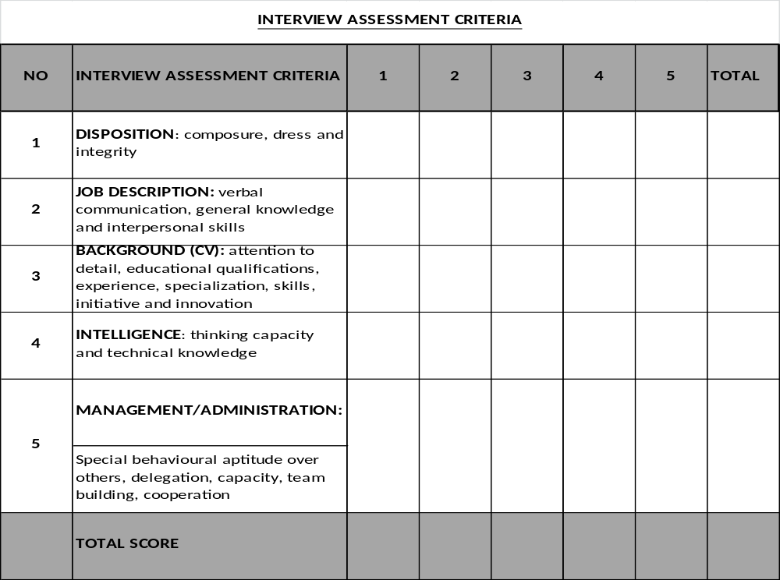

Slide 18
The Actual Interview
While interview questions are some of the most common, they are also some of the toughest.
Even though they’re asked in most interviews, these questions often throw most people off for whatever reason because they don’t know exactly how to approach the answers.

Slide 19
AS THE ACTUAL INTERVIEW STARTS
Look everyone in the eye and smile. Looking people in the eye telegraphs alertness, and smiling will signal friendliness.
Do not rush into answering the question before you understand what it entails. Politely request the interviewer to repeat the question if you did not get it right.
For general questions that have not stipulated the number of points you must give, say as much as you can. For the specific questions, give at least all the points that are required, and actually number them either as i….; 2…..; 3……; 4……. Or firstly, secondly, thirdly, fourthly, so on and so forth

Slide 20
If you can only manage to provide few answers required at that particular time, request the chairperson if he/she could accord you another opportunity to respond to the question again at the opportune time within the interview time.
Do not be too fast in answering the questions because what you say is documented almost verbatim by each member of the interview board. Say “thank you” at the end of each response to signal that you are done with that particular question.
If the chairperson requests you to ask to any question at the end of the interview, and you have nothing to ask, thank the Commission for having shortlisted you to be interviewed and the interview board for taking their time to interview you.
Make sure all your documents have been collected as you leave the interview venue.

Slide 21
THE MOST COMMON GENERAL QUESTIONS
Explain briefly why you think you are the most suitable candidate for this post.
Why would you consider the Teaching Service Commission unfair if they did not invite you for this interview?
Why do you want to be engaged for the vacancy that you applied for?
4. What have you been doing in the past two years?

Slide 22
What the interviewer is looking for
What the candidate is worth: - qualifications, experiences, special attributes (team building, integrity, honesty)
Vision
Achievements: success stories of efficiency/accomplishments
Passion for the profession: commitment to make students succeed
Work ethics and values
Extra-curricular activities

Slide 23
Common wrong responses
I am the most suitable candidate because you invited me to feel the vacant post.
You already know that a degree holder is at grade TI and I don’t know why you invited me for this interview when I already qualify.
The Teaching Service Commission would be unfair to leave me out because I have stayed at the same grade for many years and I want to be promoted
Promotion is a motivation. It would make me earn a little more and work harder

Slide 24
Common average responses
(a) I am the most suitable candidate for the post because I qualify and have taught for many years;
(b) I have experience to do the job.
(c) I do everything that the head teacher delegates to me
(d) I work with minimum supervision but maximum output
(e) I am a man of integrity, full of honesty and hardworking

Slide 25
Acceptable responses
In your advertisement for the post, you wanted a holder of any of the following degrees: Bachelor of Education, Bachelor of Science (Education) and Bachelor of Arts. I have a Bachelor of Education degree which I obtained at Chancellor College in 2008 with majors in English and Theology. I also have a Diploma in Education and a teaching certificate.
The advert also asked for someone who is a serving teacher at TL, TK, and TJ grade. I have served for 8 years at TJ grade.

Slide 26
I have wide experience as a teacher. I have taught my subjects of specialization, that is, English and Bible Knowledge in both the Junior and Senior sections for 20 years.
I have been very successful in these subjects. For example, in the 2014 MSCE examinations, I produced 35 distinctions in English, and only two failed. In 2015, I repeated my success story and everybody passed. I had 40 distinctions in the subject. You can verify this information with my school authorities.

Slide 27
I attribute my success story to my hard working spirit accompanied by my love for the profession. I have deep passion for my job and wouldn’t want my students to fail. I work with very minimum supervision but with maximum output as stated.
In my 20 years of service I have held so many responsibilities which include Acting Head of Department, Coordinator for the Open School, School teacher bursar, and boarding master.
As teacher bursar, I have proved to be honest and a man/woman of integrity by accounting for all the revenue collected. All my audited records are clean.

Slide 28
While I was in college I did courses which have direct bearing on my practice as a teacher. For example, I learnt child psychology and sociology of education. These courses assist me today to guide and counsel my learners well as the schools chairperson of Guidance and Counselling Committee.
If successful in this interview, I hope my new position will accord me with opportunities to contribute even more to the attainment of quality education in Malawi.
ANOTHER COMMON GENERAL QUESTION
If picked for this post, can you state and explain five duties that you will be required to perform.

Slide 29
THE MOST COMMON PRACTICAL QUESTIONS
A teacher is a planner. State four functions you will be expected to do in planning.
. Prepare schemes and records of work
. Prepare lesson plans
. Prepare teaching notes
. Identify and prepare learning materials

Slide 30
Explain at least FOUR factors that make schemes of work important in your teaching.
(a) Schemes enable the teacher to ensure that all sections of the syllabus are covered Schemes help the teacher to divide/segment the lessons
(b) They aid in the preparation of lesson plans
(c) They provide smooth takeover when the officer allocated to teach the subject is absent or has transferred, for continuity
(d) They are a record monitored by Ministry officials for quality control

Slide 31
Explain how guidance and counselling is significant to learners in secondary schools.
(a) Guiding on future career based on strong subject choices
(b) Providing emotional support to problems faced by the students
(c) Supporting learners with psycho-social problems emanating from the status of the family
(d) Helping learners achieve equal status in the school
(e) Team building

Slide 32
As a form teacher, what would be your responsibilities at least four of these.
(a) Monitoring attendance
(b) Compiling class results
(c) Attending to the welfare of students
(d) Overseeing the cleanliness of the classroom

Slide 33
How do you motivate your students to become active learners in your class?
(a) First impression: eloquence, presentability, humour
(b) Learner-centred approach
(c) Interactive learning
(d) Explaining the materials in a friendly manner
(e) Honesty
(f) Lively lessons, games, humour and fun
(g) Providing rewards, positive reinforcement
(h) Use of technology
(i) Effective use of teaching and learning materials
(j) Timely feedback after giving them a task
(k)Trendy and well-versed with the current developments in education

Slide 34
State four elements you would look for when supervising a teacher.
(a) Preparation: availability of schemes, lesson plan and teaching and learning aids
(b) Presentability
(c) Knowledge of the subject matter
(d) Effectiveness
(e) Proper use of teaching and learning materials
(f) Correct pacing during lesson presentation
(g) Spreading of questions

Slide 35
Why is a mark-book is important?
(a) It is a record that guides the teacher to check the progress of each particular learner
(b) It provides feed back to the school, authorities and parents on the performance of the students
(c) It facilitates promotion of successful students to the next class
(d) It enables the teacher to select students who may need remedial lessons.

Slide 36
How would you improve the quality of teaching and learning at the institution?
(a) TALULAR
(b) Following a recommended curriculum
(c) Teaching every allocated period
(d) Punctuality
(e) Planning my work well: writing schemes and records of work; lesson plans
(f) Giving students tasks to perform: assignments
Assessment
(g) Feedback
(h) Team teaching/planning/marking

Slide 37
THE MOST COMMON GENERAL QUESTIONS
Why should a teacher uphold good conduct in the school?
(a) Uphold professionalism
(b) Instil morale, morality and give sense of direction
(c) Achievement of better results

Slide 38
Explain what is meant by social distance between learner and teacher. Why is it important?
(a) It is a formal respectful relationship between a teacher and a learner/ maintenance of a clear boundary between a teacher and a learner.
(b) There is no equal status between a teacher and a learner
(c) Avoidance of emotional relationship that will culminate into misbehaviour

Slide 39
- teacher-learner relationship to be strong facilitation/impartation of knowledge to the learner
- the importance is teacher integrity it may erode self-respect and dent reputation of the teacher and the establishment

Slide 40
How does research contribute to effective teaching and learning?
- It improves innovation and creativity
- Abreast with current developments
- Provides new and better direction
- Unveiling problems in the teaching and finding solutions to those problems

Slide 41
What does the word delegation mean and why is it important in schools?
- Delegation means assigning someone or a group of people to carry out specific given tasks on behalf of the one in authority
(a) To give oneself time to perform other important duties, e.g. supervision

Slide 42
(b) To provide an opportunity for the subordinates to be trained on decision making as they carry out assigned tasks
(c) To create a growing sense of responsibility
(d) To increase teachers’ sense of belonging
(e) To motivate staff members
(f) To reduce indispensability

Slide 43
What factors do you consider when delegating responsibilities to staff?
(a) The nature of task requiring delegation
(b) The capacity of the officer to be delegated
(c) Responsibility/ trustworthiness/ integrity
Why have an Internal Procurement Committee (IPC) in the school?
(a) For value for money
(b) For transparency and accountability
(c) Conflicts of interest are identified and managed
(d) To check on fraud and corruption
(e) For fair treatment of suppliers
(f) To promote unity within the school

Slide 44
How do you motivate a teacher?
(a) Recognition
(b) Delegation
(c) Participation
(d) Communication
(e) Staff development
How can you improve gender equality at the institution?
(a) Class participation
(b) Group work with mixed sexes

Slide 45
THE END
“Ndagha fiyo”

